Slide 1


Visvesvaraya Technological University Jnanasangama, BELAGAVI
Project Phase I
“AN EXPERIMENTAL INVESTIGATION ON ANTISKID INTERLOCKING CEMENT CONCRETE PAVER BLOCKS PARTIALLY REPALCEMENT OF RIVER SAND (FA) BY WASTE FOUNDRY SAND”
Presented by:
CHANDANA M H
[USN: 2LG21CV005]
DEVAKKA
[USN: 2LG21CV006]
SHAMEEM BEGUM
[USN: 2LG22CV422]
SHAMSHAD BEGUM
[USN: 2LG21CV023]
Co-Guide:
Dr. Vinayak Vijapur
Asst. Professor,
CED, GEC, Talakal
Guide:
Prf.shreedar K R
Asst. Professor,
CED, GEC, Talakal
Department of Civil Engineering
GOVERNMENT ENGINEERING COLLEGE, TALAKAL – 583 238.

Slide 2
CONTENTS
Introduction.
Literature review / Summary.
Objectives of the Projcet.
Materials and methodology.
Study on the materials
References.
Papers Published.
Photo gallery.

Slide 3
Chapter 1: INTRODUCTION
Concrete:
Concrete is the back bone of construction industries around the world. The concrete is increasing day by day as a population of human are increasing as per their demand.
Primary constituent of concrete like cement, coarse aggregate, fine aggregate and water and it leads us as to various sustainable issues.

Slide 4
WASTE FOUNDRY SAND
Waste foundry sand by product of metal casting foundries.
It is made up of high quality uniform silica sand that is used to make moulds and corse of ferrous and non ferrous metal casting.
Foundry sand typically comprises of >80% high quality silica sand, 5-10% bentonitic clay, 2-5% water and less than 5% sea coal.

Slide 5
WASTE FOUNDRY SAND USES
Foundry sand is reused within the foundry several times until the becomes unsuitable for mold construction.
Approximately 9 to 10 million tons of foundry sand is discarded
As estimated 28% of discarded foundry sand is reused primarily construction related application

Slide 6
PROPERTIES OF WASTE FOUNDRY SAND
The major component of foundry sand is silica which is present high amount in foundry sand and this component is also present n natural sand but in lower amount as compare to foundry sand.
The waste foundry sand depends on properties such as
Physical properties of waste foundry sand.
Chemical properties of waste foundry sand.
Mechanical properties of waste foundry sand.

Slide 7
Physical properties of waste foundry sand
Particle shape of waste foundry sand is typically subangular to rounded.
The value varies from 2.39 to 2.35 pf specific gravity for waste foundry sand.
It is non plastic and has low absorption.

Slide 8
Chemical properties of waste foundry sand
It is depending on the types of metals and binder used.
The PH of waste foundry Sand range from 4-8.
Some waste foundry sand can be corrosive to materials.
It consists primarily of silica sand, coated with a thin film of burnt carbon, residual binder (bentonite, sea coal, resins) and dust.

Slide 9
Mechanical properties of waste foundry sand
Waste foundry sand density is typically between 1440-1784 kg/m3.
Waste foundry sand absorbe more water than natural sand which can increases the porosity of the mortar, this can make the mortar less compact of the less resistant.

Slide 10
LITRATURE REVIEW
SI NO | AUTHORS | TITTLE | YEAR | WORK ON
1 | J R Nayak | Application of foundry by product material is manufacture of concrete and masonary product. | 1996 | At 28 day of solidification the compressive strength values of the concrete and waste foundry sand mixture of were about 23% and 33% lower than control concrete while mixing strength of concrete new and clear foundry sand was almost the same as that of the control concrete.
2 | Khatib et.al | Reusage of waste foundry sand in oridinary concrete | 2010 | Variable proportion (0,20,40,60,80,100) and absorbes systematic lose of slump values from 200mm to 0mm.

Slide 11
3 | Guney | Reusage of waste foundry sand in high strength concrete | 2010 | An increases in the replacement level of the conventional fine sand with waste foundry sand decreases the compressive and tensile strength as well as elasticity modulus of the concrete and 10% of waste foundry sand.
4 | Basar and Akasol | Application of waste foundry sand in manufacture of concrete | 2011 | The potential raise way of waste foundry sand produces that is lighter conventional concrete but it is density still in range of 20,000 to 26,000 kg/m2 which is effective for ordinary concrete grades.
5 | Singh and sidneq | Effect of waste foundry sand partially of replacement of sand on the strength ultrasonic pules velocity and probability concrete. | 2012 | The 28 days of concrete compressive strength increased by 12% there is no significant increasing strength which can be attribute to an increasing in the surface area of fine particle

Slide 12
6 | Cauretal | Properties of concrete containing fungal treated waste foundry sand | 2012 | Fungal culture about 5% teat a 2% of waste foundry sand substituent and report a 15.6$%increasing concrete 28 days compressive strength.
7 | Maschioni | Experimental on the practiability of the application of spent waste foundry sand for the manufacture paver units | 2012 | The found the 50% of strength foundry sand is idol for the production paver blocks.
8 | Prabhu et.al | Properties of concrete in partial replacement of waste foundry sand by river sand. | 2014 | Compressive strength deceases upto 6.8% by partial replacement by waste foundry sand by river sand.

Slide 13
9 | Gaurav rohan ragendra | Partial replacement of river sand by waste foundry sand with addition of fiber | 2014 | Compressive strength decreases upto 20% by partial replacement of waste foundry sand additional of fiber
10 | Kenal | Study the properties of paving unit made of geopolymer with used waste foundry sand. | 2015 | It is reported that the addition of used foundry decreasing the strength of paver block.
11 | Vema reddy cheori | Usage of waste foundry sand in concrete | 2015 | Worakbility and compressive strength foundry sand increases the compressive strength and split tensile strength were increases the foundry sand in concrete mix upto 60% and decreases after 100%.

Slide 14
12 | Mahima ganesha | Waste foundry sand has replacement for fine aggregate in hifh strength of solid concrete masonary block | 2016 | The obtained that is incorporation of waste foundry sand increasing the strength of block optimum percent was found between 20-30%.
13 | Solaka and B deasi | Application of waste foundry sand | 2016 | It was found that compressive strength at 7 days of M20 grade of concrete was maximum for 30% replacement of ferrous waste foundry sand were it was same for 10% replacement of non ferrous waste foundry sand.
14 | Durshtant and Ramesh bhai | Experimental investigation concering the water absorption and compressive strength and concrete nut partially replacement waste foundry sand. | 2016 | Water absorption and maximum increases upto 50% replacement of fine aggregate by used waste foundry sand .

Slide 15
15 | U k paka | Assissment of concrete produces with waste foundry sand partially replacemnt waste foundry Sand by river sand. | 2016 | Maximum compresive strength increase at achive 15% replacement in fine aggregate by used river sand
16 | Supriya kulakarini and vikkat kati | Study the properties of paver block made with waste foundry sand. | 2017 | The study in compressive decreases with the wasre foundry sand percentage increases and percentage of water absorption increases with the percentage of waste foundry sand.
17 | Santos | Investigate the properties with the interlocking property made using waste foundry sand | 2018 | It is found that the strength in compressive was in compressive to the specification.

Slide 16
18 | Kauswalli tausif | Experimental study on foundry sand usage in paver blocks | 2018 | The maximum strength in compressive was achived at foundry sand usage of 10% of the fine aggregate mass.
19 | T sravani | Experimental study on particle replacement of fine aggregate with waste foundry sand in concrete. | 2018 | Maximum compressive strength of split tensile strength was obtained with 40% replacement of waste foundry sand for 28 days/
20 | Salim p m | Strength pf paver blocks by incorportally using foundry sand | 2019 | The strength in compression and water absorption of the paver blocks incorporating used foundry sand increasing up 30% and 20% with respectively.

Slide 17
SUMMARY OF THE LITRATURE REVIEW

Slide 18
GAP IDENTIFIED

Slide 19
OBJECTIVES OF THE PROJECT WORK
To examine the effect of waste foundry sand in M40 .i.e.(high grade of concrete).
To attain the requried specific strength in control mix.
To compare the mechanical properties i.e (compressive strength, splitting tensile strength and flexural strength of concrete containing waste foundry sand by partially replacing regular sand with conventional mix.
to find the optimum percentage of waste foundry sand, so it can be used without any negatively affecting the properties of concrete and can be used suitably for making concrete paver blocks.

Slide 20
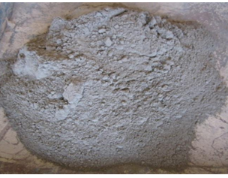
Chapter 4
MATERIALS AND METHODOLOGY
Ordinary Portland cement (OPC) 53 grade conforming to IS 12269 – 1987:
Sl. No. | Material property | Results obtained | Permissible limits as per IS 12269 - 1987
1 | Specific gravity |  | 3.12 – 3.19
2 | Fineness | 1% | Less than 11%
3 | Normal consistency | 29% | Less than 34%
4 | Initial setting time | 4Ominutes | More than 30 minutes

Slide 21
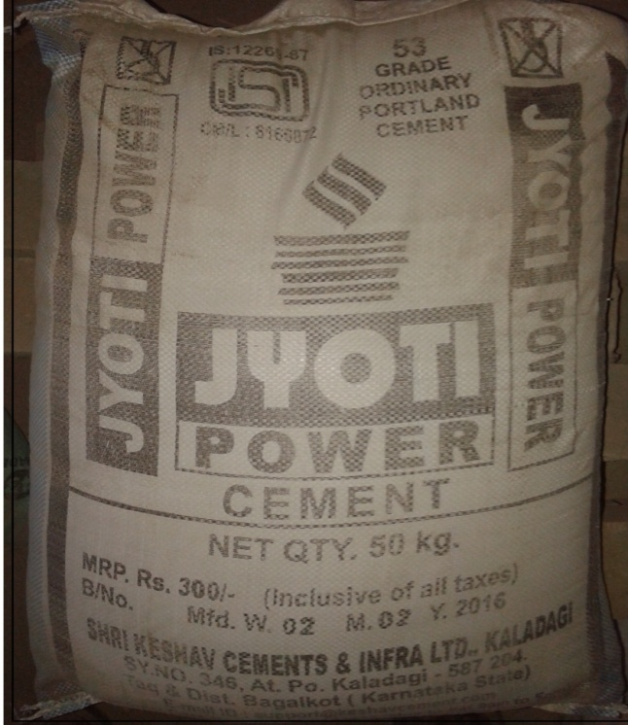
Chemical composition of cement (OPC 53 grade):
Chemical composition | Percentage
Lime [CaO] Silica [SiO₂] Alumina [Al₂O₃] Calcium Sulphate [CaSO₄] Iron Oxide [Fe₂O₃] Magnesia [MgO] Sulphur trioxide [S₂O₃] Alkalies TOTAL | 62 22 05 04 03 02 01 01 100%

Slide 22
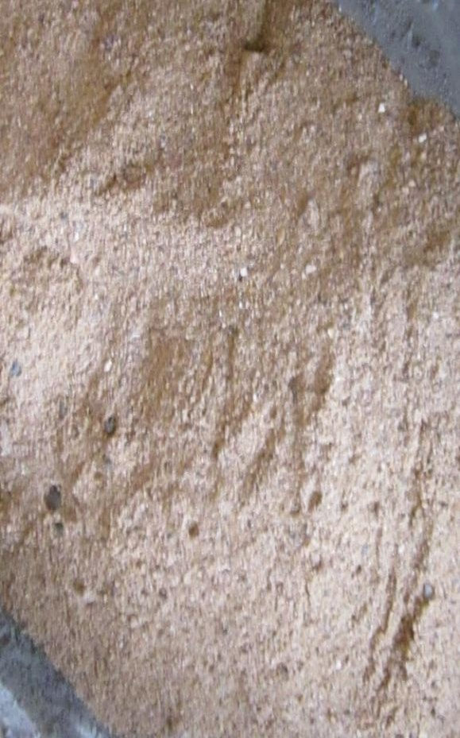
Fine aggregate: Locally available river sand conforming to zone-II of IS 383-1970:
IS Sieve size | Cumulative percentage passing of fine aggregates | Specifications for Zone II as per IS:383-1970
Pan

Slide 23
Coarse aggregate: Locally available crushed angular aggregates confirming to IS 383-1970:
IS Sieve size | Percentage passing of coarse aggregates |  | Percentage passing of different fractions |  |  | Specifications as per IS:383-1970
 | I (20mm) | II (12.5 mm) | I 60% | II 40% | Combined 100% | Graded | Single sized
 |  |  |  |  |  |  | I | II
20 mm | 100 | 100 | 60 | 40 | 100 | 95-100 | 85-100 | --
12.5 mm | 0 | 98.50 | 0 | 0 | 0 | -- | -- | 85-100
10 mm | 0 | 35.20 | 0 | 29.50 | 29.50 | 25-55 | 0-20 | 0-45
4.75 mm | 0 | 8.40 | 0 | 4.10 | 4.10 | 0-10 | 0-5 | 0-10
Specific gravity = 2.63
Bulk density = 1783 kg/m³
Water absorption = 0.54%

Slide 24
Water.
BIS: 10262 - 2009
Water fit for drinking is generally considered fit for making concrete.
Water should be free from acids, oils, alkalies, vegetables or other organic Impurities.
Water has two functions in the concrete mix:
Firstly it reacts chemically with the cement to form a cement paste in which the inhert aggregates are held in suspension until the cement paste has hardened.
Secondly, it serves as a vehicle or lubricant in the mixture of aggregates (FA & CA) and cement.

Slide 25
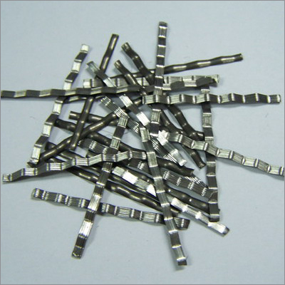
Steel fibers: Crimped steel fibers.
Parameter | Values
Size | 1.00 mm (Thick)
Length | 35 mm
Aspect Ratio | 35
Tensile strength | 1100 MPa
Ultimate Strength | 1395 MPa
Density | 7850 kg/m³
Young’s Modulus | 210 GPa

Slide 26
WASTE FOUNDRY SAND

Slide 27
4.2 Methodology:
Equipment used for conducting various tests:
Workability equipment like slump cone, compaction factor test apparatus, Compression testing machine (CTM).
Flexural testing machine.

Slide 28
Basic tests on materials:
Standard consistency test, initial setting time and final setting time of cement, Specific gravity of cement.
Specific gravity of fine and coarse aggregates.
Sieve analysis of fine and coarse aggregates.
Fineness modulus of fine and coarse aggregates.
Density of fine and coarse aggregates.

Slide 29
Contd. Basic tests on materials:
Test on fresh concrete - Workability characteristics:
Slump test.
Compaction factor test.

Slide 30
Contd. Basic tests on materials:
Test on hardened concrete - Strength characteristics:
Compressive strength.
Tensile strength.
Flexural strength.

Slide 31
Mix Design for M30
Grade of Concrete | Cement | Fine aggregate | Coarse aggregate | w/c ratio
M30 | 413.33 | 641.88 kg/m³ | 1131.66 kg/m³ | 186.00 L
 | 1 | 1.47 | 2.48 | 0.45

Slide 32
Thank you....

